Slide 1

Lecture 7 Introduction to Cloud Computing

Slide 2
Main Topics
Cloud Computing: The Ideas and The Definitions
Cloud Computing Services: Case studies
Cloud Computing: Characteristics

Slide 3
The idea of computing in a “cloud” …
Track back to the origins of utility computing
A concept that computer scientist John McCarthy proposed in 1961
“If computer of the kind I have advocated become the computers of the future, then computing may someday be organized as a public utility just as the telephone system is a public utility…… The computer utility could become the basis of a new and important industry”

Slide 4
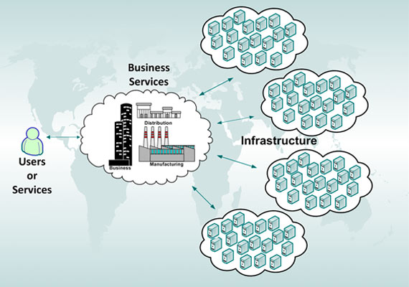
Utility Computing

Slide 5
What is Utility Computing
Providing computing service through an on-demand, pay-per-use billing method.
A computing business model in which the provider owns, operates and manages the computing infrastructure and resources, and the subscribers accesses it as and when required on a rental or metered basis.
The term utility refers to utility services such as electricity, gas, …
Utility computing with added features
the total amount of web storage space and computing power much larger compared to that of the single time-sharing computer
Multiple backend web servers often used to make such service possible
The dedicated web servers may be used in cluster forms
distributed computing
Cloud computing, grid computing and managed IT services are based on the concept of utility computing.

Slide 6
Benefit of Utility Computing
better economics
Corporate data centers are notoriously underutilized
resources such as servers often idle 85% of the time
This is due to overprovisioning
buying more hardware than is needed on average in order to handle peaks (i.e. flash events)
to handle expected future loads and to prepare for unanticipated surges in demand.
Utility computing allows companies to only pay for the computing resources they need, when they need them.

Slide 7
Internet based computer utilities
Rapid developments
Search engines (Yahoo!, Google, …)
Email services (hotmail, gmail, …)
Open publishing platforms (MySpace, Facebook, YouTube, …)
Other types of social media (Twitter, LinkedIn, …)
…
Though consumer-centric, these services popularized and validated core concepts that form the basis of cloud computing

Slide 8
Cloud Computing
Think of it as Internet Computing
Computation done over the internet
Enabled through
High Bandwidth and High Speed Internet
Utility Computing
Virtualization
…

Slide 9
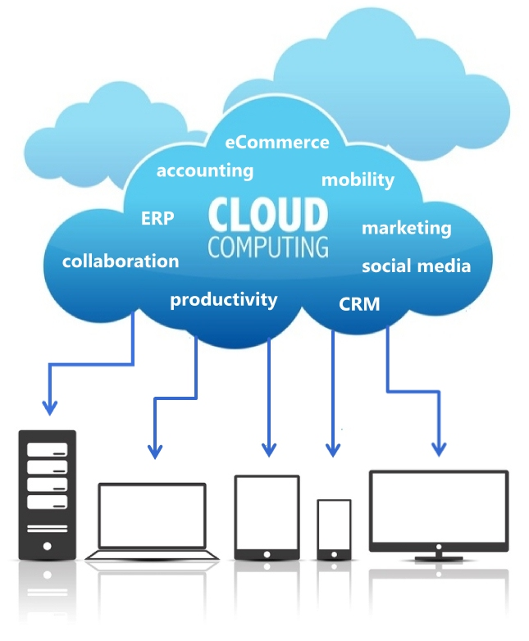
So, what is cloud computing?

Slide 10
Cloud Computing: what we know
Cloud computing is consumption of computing resources without worrying about specifics
Has the ability to add or remove resources according to the demand
Similar to the power grid and telephone network

Slide 11
How does it work?
Consumer signs up for the service
Same as if you get a mobile phone plan
Consumer uses services according to their needs
Provider sends the bill at the end of the cycle
Consumer pays

Slide 12
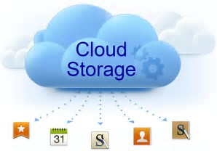
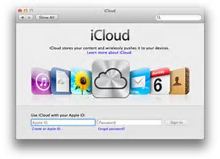
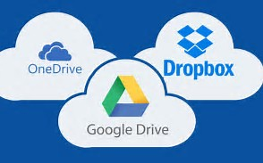
Example: Cloud Storage
Most popular, simplest cloud service

Slide 13
Activity #1: Discussion
Use a popular cloud storage service to explain the idea and principle of cloud service.
Answer the following questions briefly.
What does it mean “pay per use”?
Who owns the storage space?
What’s the benefit of using cloud storage compared with using local storages such as hard drives, flash drives, etc.

Slide 14
Definition of Cloud Computing
“…a standardized IT capability (service, software, or infrastructure) delivered via Internet technologies in a pay-per-use, self-service way. ” (Forrester Research, 2008)
“Cloud computing is a model for enabling ubiquitous, convenient, on-demand network access to a shared pool of configurable computing resources (e.g. network, severs, storage, applications, and service) that can be rapidly provisioned and released with minimal management effort or service provider interaction.” (NIST –National Institute of Standards and Technology, 2011)

Slide 15
many different definitions, but same fundamental concept
“… the practice of using a network of remote servers hosted on the Internet to store, manage, and process data, rather than a local server or a personal computer.” (google)
Cloud computing is shared pools of configurable computer system resources and higher-level services that can be rapidly provisioned with minimal management effort, often over the Internet. Cloud computing relies on sharing of resources to achieve coherence and economies of scale, similar to a public utility. (Wikipedia)
…

Slide 16
Activity #2
Use your own words to definite “Cloud Computing”.
You signed up a cell phone service, pay monthly. Would this service provided by a mobile provider be considered as a utility computing service? As a cloud computing service?

Slide 17
Cloud computing – beyond the definition
Cloud computing: Software and hardware service over the internet
No specific resource requirement on your own computer
Cloud: a “buzzword” for internet
Many companies now offer cloud services
Some offer free services
Mostly you pay for use of the services
Also called data intensive computing
Suitable for applications on very large data sets

Slide 18
Sample Prices
Note: prices changing all the time
Amazon | Compute $0.10+ VM/Hr Storage $0.15+ GB/Month Bandwidth $0.15+ GB/XFer
Rackspace | Compute $0.02+ VM/Hr Storage $0.15+ GB/Month Bandwidth $0.22+ GB/XFer
Microsoft | Compute $0.12 VM/Hr Storage $0.15 GB/mo Bandwidth $0.15 GB/Xfer

Slide 19
Pros and Cons
Advantages
Can access from anywhere
Easy to store/backup data
No worry about hard drive loss
Unlimited scalability
Scale up and down when your business goes up and down
Cost efficient
Don’t have to pay for staff/hardware/maintenance
Disadvantages
No service available without the internet
Rely on other company to keep your data safe and secure
Security issues (account get hacked and data stolen – completely out of your control)
Easily locked in
Easier to move data in, harder to get out

Slide 20
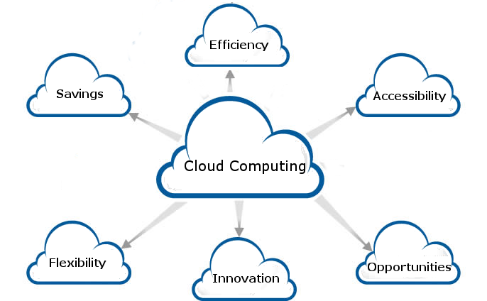
Benefits of Cloud Computing
blog.icorps.com

Slide 21
Cloud Computing: cost effectiveness
IT cost
Hardware
According to IDC (International Data Corporation) survey, hardware cost in global IT industry remains stable
Energy
Energy cost rises
Management
Management cost rises significantly

Slide 22
Cloud computing: cost comparison
Cloud computing reduces infrastructure and management cost significantly, for example
X: a large-scale data center of 50,000 servers
Y: a medium-scale data center of 1,000 servers
 | Y | X | Ratio (Y:X)
network | $95 per mb/sec/mo | $13 per Mb/sec/mo | 7 : 1
storage | $2.20 per GB/mo | $0.40 per GB/mo | 5 : 1
management | Each IT manager manages about 140 servers | Each IT manager manages 1000+ servers | 1 : 7
Note: James Hamilton data

Slide 23
Cloud computing: Energy cost
Difference in energy cost
Strategies
Questions: where are the major data warehouses/centers located?
State | Cost per kwh | Possible reason
Idaho | ~3.6 cents | Hydro-power, no long distance transmission
California | ~10 cents | Not allow coal generated power, require long distance transmission
Hawaii | ~18 cents | …
Note: data may not be very accurate

Slide 24
Benefits of cloud computing
Cost effectiveness
No front setup cost
Less maintenance: Hardware, applications and bandwidth are managed by the provider.
All benefits of utility computing …
Virtualization and scalability
Scalability: Pay only for the applications and data storage you need.
Continuous availability: Public cloud services are available wherever you are located.
All benefits of grid computing …

Slide 25
Cloud Computing: Essential Characteristics
On-demand self-service: A consumer can unilaterally provision computing capabilities as needed automatically without requiring human interaction with each service’s provider.
Examples of computing resources: server time and network storage
Broad network access: Capabilities are available over the network and accessed through standard mechanisms that promote use by heterogeneous thin or thick client platforms
Sample client platforms: mobile phones, laptops, and PDAs.

Slide 26
Resource pooling: The provider’s computing resources are pooled to serve multiple consumers using a multi-tenant model, with different physical and virtual resources dynamically assigned and reassigned according to consumer demand. There is a sense of location-independence in that the customer generally has no control or knowledge over the exact location of the provided resources but may be able to specify location at a higher level of abstraction (e.g., country, state, or data center).
Examples of resources include storage, processing, memory, network bandwidth, and virtual machines

Slide 27
Rapid elasticity: Capabilities can be rapidly and elastically provisioned, in some cases automatically, to quickly scale out and rapidly released to quickly scale in.
To the consumer, the capabilities available for provisioning often appear to be unlimited and can be purchased in any quantity at any time.

Slide 28
Measured service: Cloud systems automatically control and optimize resource use by leveraging a metering capability at some level of abstraction appropriate to the type of service
Sample services: storage, processing, bandwidth, and active user accounts
Resource usage can be managed, controlled, and reported providing transparency for both the provider and consumer of the utilized service.
http://csrc.nist.gov/publications/nistpubs/800-145/SP800-145.pdf

Slide 29
Activity #3: Wrap up
Give an example of cloud computing.
Describe the “example”, and justify why it is considered cloud computing.
Essential characteristics of cloud computing
What are they? Why these are important? (use own words to describe!)
Advantages and disadvantages of cloud computing
Use Cal Poly Pomona OneDrive service or Apple iCloud as example to discuss benefits (pros) and drawbacks (cons) of cloud computing services.

Slide 30
Next …
Evolution of Cloud Computing Evolution
Models of Cloud Computing
Main Developments of Cloud Computing
Google
Amazon AWS
Microsoft Azure
…

